Slide 1
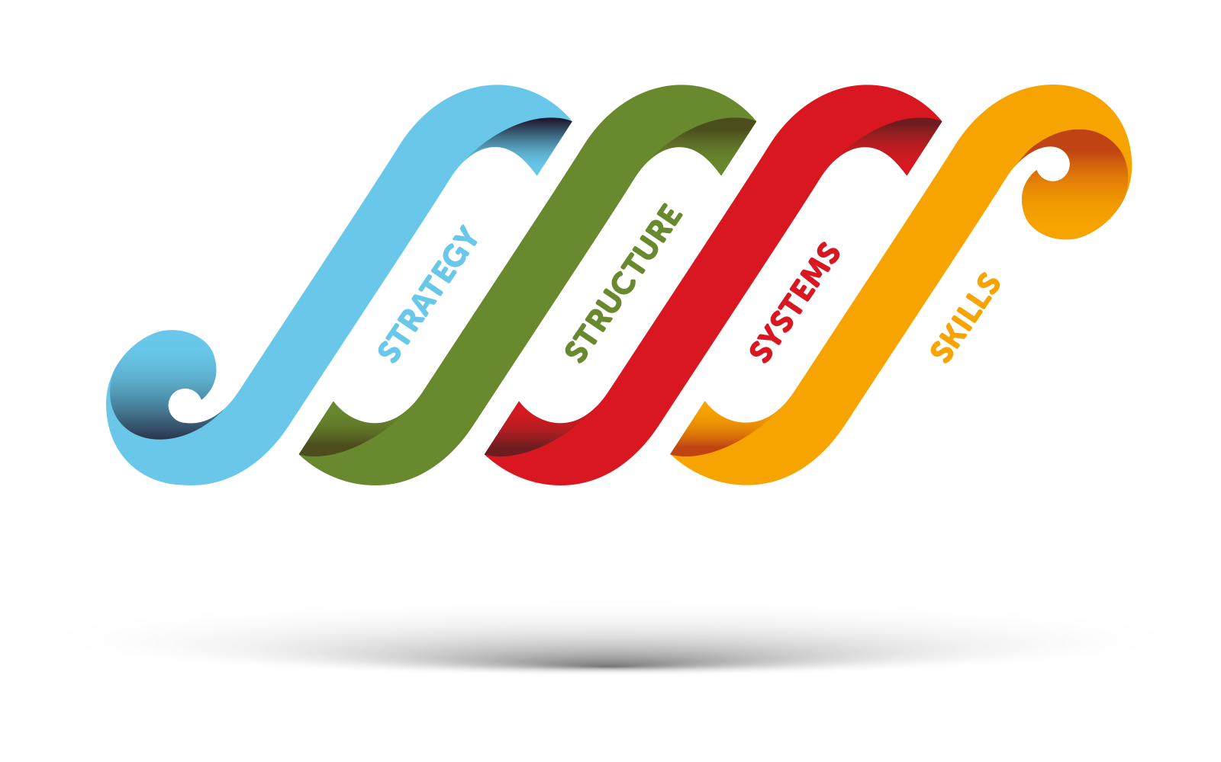
Four Waves

Slide 2
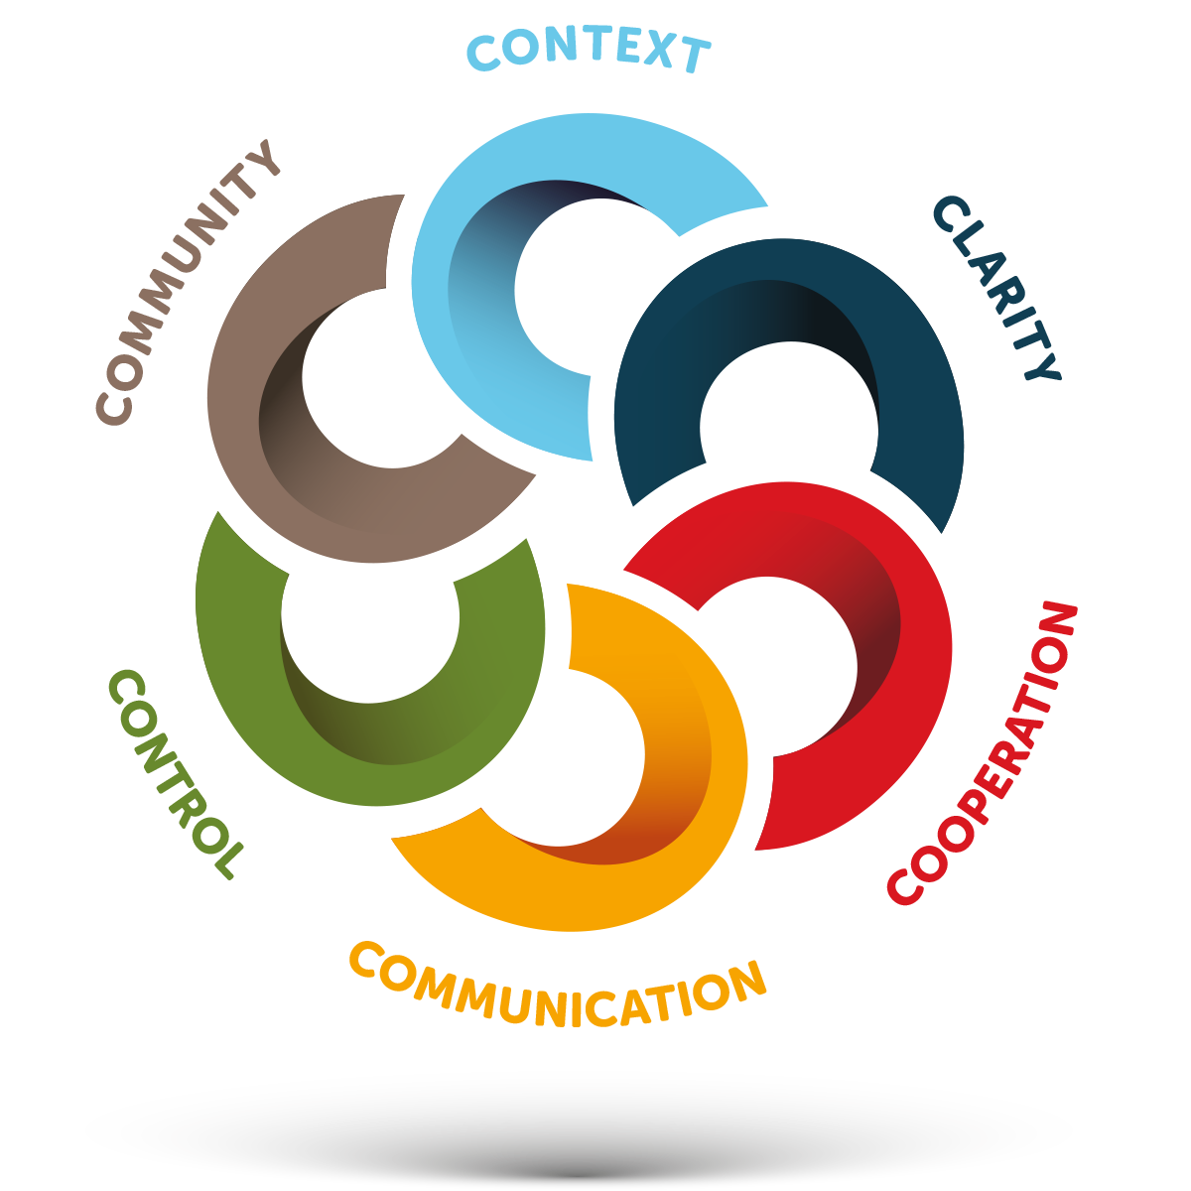
Six C’s

Slide 3

Embedding Change

Slide 4





Slide 5




Asset icons

